Slide 1
NUMBER
SYSTEM

Slide 2
DIVISIBILITY RULES

Slide 3
A number is divisible by 2, If the last digit is even. 128 Yes 129 No
A number is divisible by 3, If the sum of the digits is divisible by 3. 381 (3+8+1=12, and 12÷3 = 4) Yes 217 (2+1+7=10, and 10÷3 = 3 ¹/₃) No Question : What is the least value of x, so that 23x57 is divisible by 3. A. 2 B. 0 C.1 D.3 Ans. C

Slide 4
A number is divisible by 4, If the last two digits of the number divisible by 4. 1312 is (12÷4=3) Yes 7019 is not (19÷4=4 ³/₄) No
A number is divisible by 5, If the last digit is a 5 or a 0. 175 Yes 809 No
A number is divisible by 6, If the number is divisible by both 3 and 2. 114 (it is even, and 1+1+4=6 and 6÷3 = 2) Yes 308 (it is even, but 3+0+8=11 and 11÷3 = 3 ²/₃) No
Question: If the number 5*2 is divisible by 6, then * is ?
a.2 b.3 c.4 d.5 Ans…a

Slide 5
A number is divisible by 7, If the number formed by subtracting twice the last digit with the number formed by; rest of the digits is divisible by 7. Example: 343. 34-(3x2) = 28 is divisible by 7. 672 (Double 2 is 4, 67-4=63, and 63÷7=9) Yes
or Make the triplets from the given numbers from right end subtract first triplet with 2nd, 3rd with 4th and so on then if the sum of resultant is divisible by 7 then number is also divisible by 7.
Mostly this method is advisable to apply on number with some specific symmetrical pattern Example:8955795758 ,Divisible by 7
Explanation: We express the number in terms of triplets of digits as follows. (008)(955)(795)(758) Now, 758- 795 + 955 - 8 = 910, which is divisible by 7.

Slide 6
A number is divisible by 8, If the last three digits form a number divisible by 8. 109816 (816÷8=102) Yes 216302 (302÷8=37 ³/₄) No
Question. The number 367505*8 is completely divisible by 8. What is the smallest whole number in place of *: a.3 b.2 c.4 d.5
Ans…b

Slide 7
A number is divisible by 9, If the sum of the digits is divisible by 9. 1629 (1+6+2+9=18, and again, 1+8=9) Yes 2013 (2+0+1+3=6) No
Question. If the number 481*673 is completely divisible by 9, what is the smallest whole number in place of *: a. 2 b.8 c.9 d.7
Ans…d

Slide 8
A number is divisible by 10, If the last digit of number is 0. 220 Yes 221 No
A number is divisible by 11, If the difference between sum of digits in even places and the sum of the digits in odd places is 0 or divisible by 11. Example: 365167484 (3+5+6+4+4) – (6+1+7+8) = 0 ∴ 365167484 is divisible by 11.

Slide 9
Question.The number 97215*6 is completely divisible by 11. What is the smallest whole number in place of *: a.5 b.4 c.3 d.6
Ans…c

Slide 10
A number is divisible by 12, If the number is divisible by both 3 and 4. 648 (By 3, 6+4+8=18 and 18÷3=6 Yes) (By 4, 48÷4=12 Yes) Both pass, so Yes
Question .If the product 4864 × 9a2 is divisible by 12, then what is the value of a: a.1 b.2 c.3 d.4
Ans…a

Slide 11
Divisibility Test for 13 To find out if a number is divisible by 13 or not, follow these steps: Separate the last digit from the rest of the number. Let us call the rest of the number the truncated number. The truncated number has one less digit than the original number or the previous truncated number.
Multiply the last digit by 4 and add it to the truncated number. Check if this result is sufficiently small so that you can immediately say if this is divisible by 13. If it is divisible by 13, then so was the original number. If it is not divisible by 13, then neither was the original number.
If the number is still too large to visually check if it is divisible, apply this rule over and over again as necessary. E.g. 12675 → 1267 + 20 = 1287 → 128 + 28 = 156 → 15 + 24 = 39, which is divisible by 13. So yes, 12675 is divisible by 13.

Slide 12
DIVISION ALGORITHM OR EUCLIDEAN ALGORITHM
If we divide a given number by another number, then : Dividend = (Divisor x Quotient) + Remainder
(i) (x^n – a^n ) is divisible by (x - a) for all values of n.
(ii) (x^n – a^n) is divisible by (x + a) for all even values of n.
(iii) (x^n + a^n) is divisible by (x + a) for all odd values of n.

Slide 13
REMAINDERS

Slide 14
Introduction
Dividend = Divisor × Quotient + Remainder.
Eg: Find the remainder of [(100 + 30 * 4 - 8 ) / 7]
= Remainder[(Remainder[100/7] + Remainder[30/7] * Remainder[4/7] - Remainder[8/7] ) / 7 ]
= Remainder[(2 + 2 * 4 - 1)/7] = Remainder[9/7] = 2

Slide 15
One common mistake:
15 / 9 is same as 5 / 3, remainder 2. Correct? No 15/9 will give a remainder of 6.
make sure we multiply the remainder obtained with the common factors we removed.
Concept of negative remainder
What is the remainder when 2¹¹ divided by 3?
2 = 3 * 1 + (-1), remainder is -1,
Which is Remainder[-1/3] = -1
Whenever you are getting negative number as a remainder, make it positive by adding the divisor to the negative remainder.

Slide 16
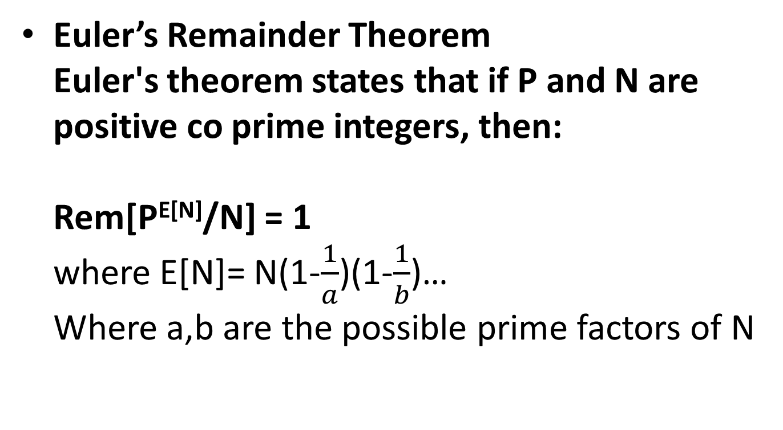
REMAINDER THEOREMS:
Euler’s Remainder Theorem Euler's theorem states that if P and N are positive co prime integers, then: Rem[P^{E[N]}/N] = 1 where E[N]= N(1-$\frac{1}{a}$)(1-$\frac{1}{b}$)… Where a,b are the possible prime factors of N

Slide 17
What is the remainder when 21⁸⁶⁵ is divided by 17?
Remainder[21/17] = 4
Remainder [ 21⁸⁶⁵/ 17 ] = Remainder [ 4⁸⁶⁵/ 17 ]
4 and 17 are co prime numbers. ( A prime number is always coprime to any other number)
φ(17) = 17 x ( 1 – 1 / 17) = 16.
So Euler’s theorem says Remainder [ 4¹⁶/ 17 ] = 1
To use this result in the given problem we need to write 865 in 16n + r form.
865 = 16 * 54 + 1, so 4⁸⁶⁵ can be written as 4^{16 * 54} x 4
Remainder[4⁸⁶⁵/17] = Remainder[ 4^{16*54}/17] * [4/17]
Remainder = 1 * 4 = 4

Slide 18
Fermat’s little theorem
Remainder of a^{( p – 1 )}/ p is 1, which is Fermat’s little theorem
We can derive other useful results like
Remainder of a^{p} / p is a.
(a^{p} – a) is always divisible by a.
Wilson’s theorem
Remainder[(p-1)! / p ] = (p-1), if p is a prime number.
We can also derive some useful results like
Remainder of [(p-1)! + 1] / p is zero.
Remainder of (p-2)! / p is 1.

Slide 19
CYCLIC PROPERTY OF REMAINDERS
For example,
Remainder [ 2¹ / 3 ] = 2, Remainder [ 2² / 3 ] = 1, Remainder [ 2³ / 3 ] = 2, Remainder [ 2⁴ / 3 ] = 1 and so on.
Pattern repeats in cycles of 2.
Remainder [ 2^{n} / 3 ] = 2 when n is odd and 1 when n is even
Eg: [ 2³²⁷⁶ / 3 ] = 1(remainder)

Slide 20
Take another example with 9
Remainder [ 9¹ / 11 ] = 9, Remainder [ 9² / 11 ] = 4, Remainder [ 9³ / 11 ] = 3 , Remainder [ 9⁴ / 11 ] = 5
Remainder [ 9⁵ / 11 ] = 1, Remainder [ 9⁶ / 11 ] = 9, Remainder [ 9⁷ / 11 ] = 4, Remainder [ 9⁸ / 11 ] = 3
Pattern repeats in cycles of 5.
[ 9¹⁰⁰ / 11 ]=1(remainder), 100 is in form 5n

Slide 21
FEW CONCEPTS CAN BE USED
Remainder[(ax + 1)^{n} / a] = 1 for all values of n.
Remainder[(ax - 1)^{n} / a ] = 1 when n is even
Remainder[(ax - 1)^{n} / a ] = (a-1) when n is odd.
Remainder[(a^{n} + b^{n}) / (a + b) ] = 0 when n is odd.
Remainder[(a^{n} - b^{n}) / (a + b) ] = 0 when n is even.
Remainder [(a^{n} - b^{n}) / (a - b) ] = 0

Slide 22
Practice
1. What is the remainder when 13¹⁸ is divided by 19?
A.2 B.1 C.4 D.3
2. Find remainder for 9¹⁰¹/125.
A.10 B.9 C.8 D.7
Notes:
B
B

Slide 23
3. Find the remainder when 7^97 is divided by 45.
A.7 B.8 C.5 D.1
4. Find the remainder when 72^40 is divided by 41.
A.2 B.4 C.1 D.3
Notes:
3. A
4. C

Slide 24
5. Given N is a positive integer less than 31, how many values can n take if (n + 1) is a factor of n!? A.18 B.16 C.12 D.20
6. What is the highest power of 12 that divides 54!? A.25 B.26 C.30 D.4
Notes:
5. A
6. A

Slide 25
FACTORIAL

Slide 26
Introduction
The product of an integer and all the integers below it.
N!= N (N-1) (n-2)…….. 1
E.g. 4! = 4 × 3 × 2 × 1 = 24
1. How many trailing zeroes (zeroes at the end of the number) does 60! have?
A.14 B.12 C.10 D.8
Notes:
A

Slide 27
2. Given N is a positive integer less than 31, how many values can n take if (n + 1) is a factor of n!? A.18 B.16 C.12 D.20
3. What is the highest power of 12 that divides 54!? A.25 B.26 C.30 D.4
Notes:
2. A
3. A

Slide 28
FACTORS

Slide 29
Introduction
Factors of a number are the integers that can divide the original number exactly.
For example, 8 is the factor of 24, since it can divide 24 into three equal parts. 24/8 = 3.
Other factors of 24 are 1, 2, 3, 4, 6, 8, 12 and 24

Slide 30
Factors Formulas
There are basically three types of formulas considered for factors:
Number of Factors
Product of Factors
Sum of Factors
Let us assume N is a natural number, for which we need to find the factors. If we convert N into the product of prime numbers by prime factorization method, we can represent it as;
N = Xª × Y^{b} × Z^{c}
where X, Y and Z are the prime numbers and a, b and c are their respective powers.

Slide 31

NUMBER OF FACTORS
The formula for the total number of factors for a given number is given by;
Total Number of Factors for N = (a+1) (b+1) (c+1)
SUM OF FACTORS
The formula for the sum of all factors is given by;
Sum of factors of N =
PRODUCT OF FACTORS
The formula for the product of all factors is given by;
Product of factors of N = N^{Total No. of Factors/2}

Slide 32
Example
Example: Find the total number of factors of 90 along with sum and product of all factors.
Solution: 90 = 2 × 45 = 2 × 3 × 15 = 2 × 3 × 3 × 5
90 = 2¹ × 3² × 5¹
Here, X = 2, Y = 3, Z =5 and a = 1, b = 2, c = 1
Total number of factors of 90
= (a +1)(b+1)(c+1) = (1+1)(2+1)(1+1) = 2 × 3 × 2 = 12
Sum of factors of 90
= [(2¹⁺¹-1)/2-1] × [(3²⁺¹-1)/3-1] × [(5¹⁺¹-1)/5-1] = (3/1) × (26/2) × (24/4) = 3 × 13 × 6 = 234
Product of factors of 90
= 90^{Total factors of 90/2} = 90^{12/2} = 90⁶

Slide 33
Practice
Find the number of factors of 16.
4 B. 5 C. 6 D. 8
2. Find the sum of the factors of 3240.
A. 10890 B. 11000 C. 10800 D. 10190
Notes:
B
A

Slide 34
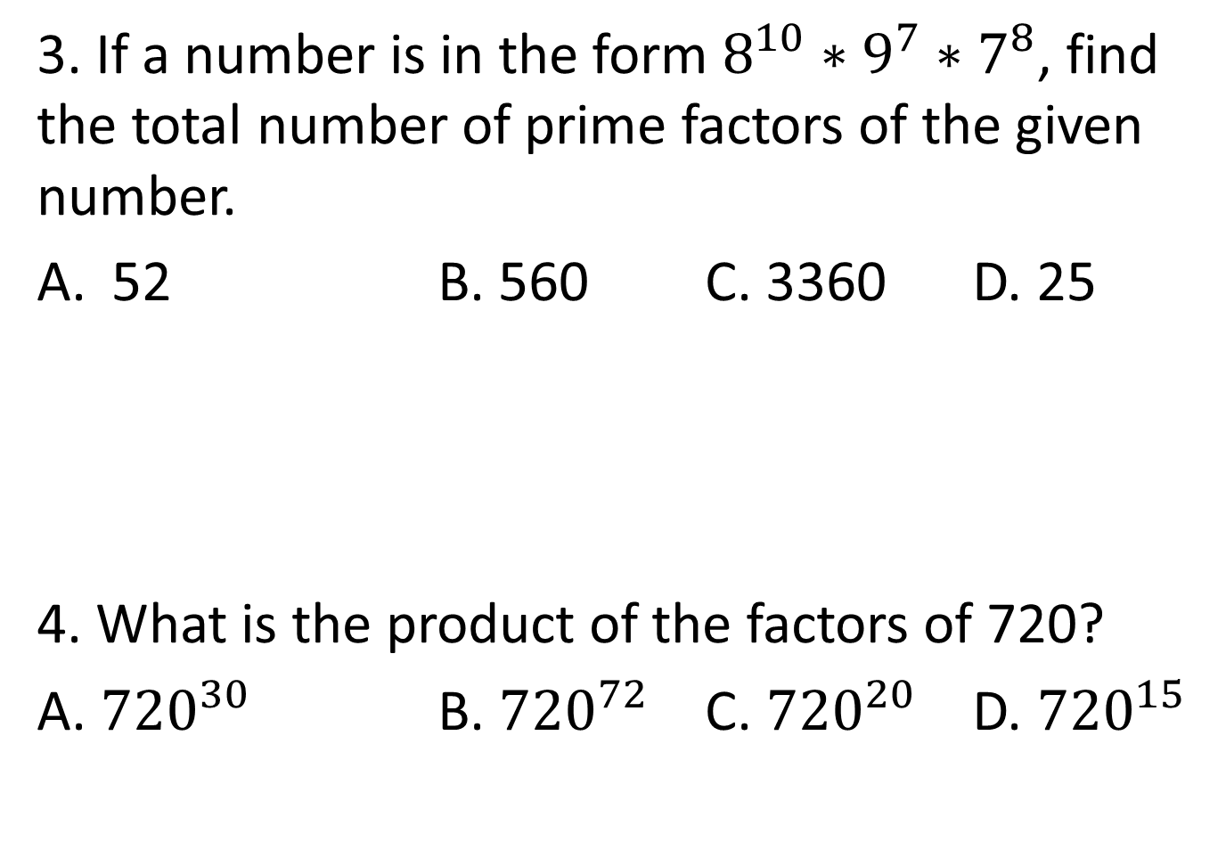
3. If a number is in the form $8^{10}∗9^{7}∗7^{8}$, find the total number of prime factors of the given number.
52 B. 560 C. 3360 D. 25
4. What is the product of the factors of 720?
A. ${720}^{30}$ B. ${720}^{72}$ C. ${720}^{20}$ D. ${720}^{15}$
Notes:
3. A
4. D

Slide 35


